Slide 1




Game 2
Space Invaders Movement

Slide 2
Space Invaders Movement ~ Introduction
The main task in relation to game 2 was to implement movement similar to that seen in the popular arcade game space invaders.
Space invaders implements the concept of pattern movement which provides the illusion of intelligent behaviour.
This movement consists of the invaders moving from side to side, whilst simultaneously moving downwards each time they reach the edge of the playable area.
This type of movement can be quite effective in bringing to life both enemy and friendly NPCs (Non-Player Characters) by giving them basic actions such as patrolling and attacking, whilst also being quite simple to implement.

Slide 3
Space Invaders Movement ~ AI Explanation
Pattern movement as its name implies works by executing a series of actions repeatedly, thus creating a pattern.
In relation to mimicking the movement seen in space invaders, the pattern involves repeatedly applying a transformation over the object according to specified parameters which will enable the invaders to move to the edge of the screen and then one layer down. Movement in the opposite direction is achieved by inverting the directional movement of said invaders whilst repeating the same pattern.
This was achieved through the use of a step counter (stepCount) which is incremented each time the invaders take a step (move in the indicated direction). When said counter reaches a specified value the invaders are moved downwards and their movement direction is inverted. Thus, the pattern starts once more.
This type of movement can be implemented simply by storing the different action in an array which is than accessed and each action is than applied. An alternative way is to use loops which repeat the movement patterns placed within based on the parameters set.

Slide 4
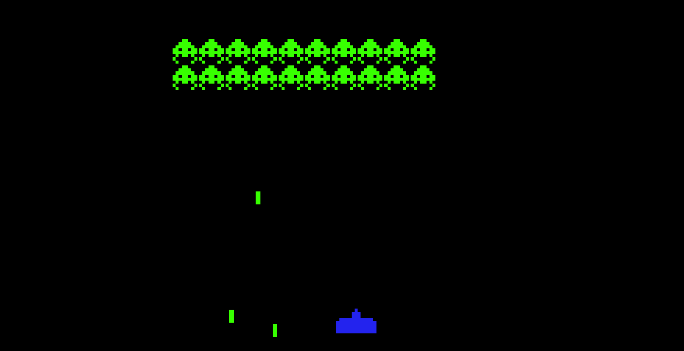

Space Invaders Movement ~ Mini-Game Implementation (1)
Playable Area:
Space Invaders
Enemy Projectiles
Player Character

Slide 5
Space Invaders Movement ~ Mini-Game Implementation (2)
The implementation of the invader movement was inspired from [1] and utilised sprites from [2]. It consisted of the following set of scripts:
The InvaderMovement script is used to implement pattern movement, which moves the invaders from the side to side and downwards.
The BulletLogic & EnemyBulletLogic scripts are used to implement the bullet movement and interaction with respect to player and enemy bullets.
The InvaderShooting script is used to individually determine when and at what intervals each invader fires their shots.
The PlayerController script facilitates player movement along the X-axis as well as providing the player with the ability to shoot.
The CheckGameStatus script checks for the winning/losing conditions. The latter involves the player being hit three times or the invaders reaching the bottom of the screen, whilst the winning condition involves the player killing each invader.

Slide 6
Space Invaders Movement ~ Exercise (1)
Now it’s your turn to Code ! – Let’s implement the pattern movement algorithm ☺
Open the InvaderMovement script and implement the following code in the FixedUpdate() method.
Note: We will be using the loop variant of pattern movement.
Check if stepCount is equal to stepNumber
If this is the case set moveRight to !moveRight and reset stepCount
Apply a transform downwards to each invader gameObject
(Hint: Use Time.deltaTime to make the movement smoother)
(Hint: Use this.transform.up * -downMovement)

Slide 7
Space Invaders Movement ~ Exercise (2)
For each invader check whether moveRight is set to True
If this is the case apply a transform to the right to each invader gameObject
If this is not the case apply a transform to the left to each invader gameObject
(Hint: Use this.transform.right * speed)
(Hint: Use -speed to invert movement direction)
(Hint: Use Time.deltaTime to make the movement smoother)
Increment stepCount for each step taken

Slide 8
Space Invaders Movement ~ Conclusion
In conclusion pattern movement has the benefit of being simple to implement whilst also providing basic behaviour to NPC’s and other facets of game development.
However, it also has its downsides, these being that due to it being a simple method it doesn’t lend itself well to the creation of complex behaviours and due to the utilisation of patterns these could be quickly identified by players which might take them out of the experience or allow for easy exploitation.

Slide 9
Space Invaders Movement ~ References
[1] – Prof. A. Dingli, ICS2211: “LEVEL 2 MOVEMENT” [Online]. Available: https://www.um.edu.mt/vle/pluginfile.php/1103257/mod_resource/content/1/Level2_Movement.pdf [Accessed: 18-Mar-2023]
[2] Zigurous. "Unity Space Invaders Tutorial - Sprites." GitHub, Available: https://github.com/zigurous/unity-space-invaders-tutorial/tree/main/Assets/Sprites [Accessed: 18-Mar-2023]

